Slide 1
Air-BnB Recommendation System
Group 7
Wong Xin Pei
Candy Lim
Tan Jun Xian

Slide 2
Agenda
Objective
Data
Algorithms
Evaluation
Conclusion
What do want to accomplish?
Exploration
Pre-Processing
Word Embeddings / Vectorization
Visualization of results
PCA + TensorBoard
TF-IDF
Doc2Vec
Cosine-Similarity
K-NN
Cosine-Similarity

Slide 3
Objective
Name | Description | Availability
User
Input

Slide 4
Data

Slide 5
Word Embeddings/Vectorization
Vector representations (numbers) of a word
Process huge text data
For Machine Learning algorithms
User Input
I want big rooms
X1
House has big rooms
 | I | Want | Big | Rooms | House | has | many | small
User Input | 1 | 1 | 1 | 1 | 0 | 0 | 0 | 0
X1 | 0 | 0 | 1 | 1 | 1 | 1 | 0 | 0
X2 | 0 | 0 | 0 | 1 | 0 | 0 | 1 | 1
X2
Many small rooms

Slide 6
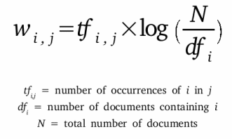
TF-IDF
Term Frequency - Inverse Document Frequency
term = word
Number of times a term (t) appeared in a doc (d)
Total number of docs (d)
*
Total number of docs (n)
Number of documents with the term (t) + 1
Log
Process of giving a word a numeric value (w)
Determines how important the word is, in the document

Slide 7
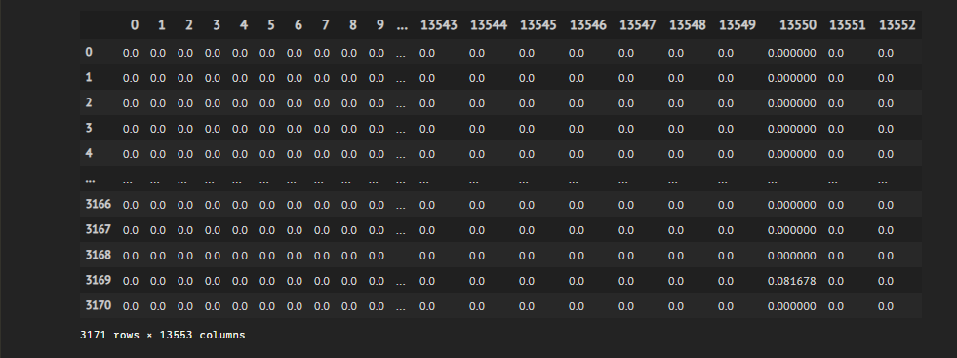

Slide 8
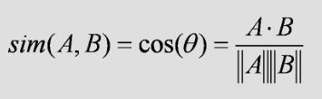
Cosine-Similarity
Determine how similar words/documents are regardless of magnitude
Where A and B are vector representations of words/documents
Since angle is small,
Similarity value will be high
Exactly same,
Similarity value will be 1
Similarity value will be 0
A
A
A
A
B
B

Slide 9
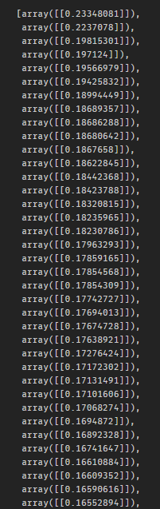
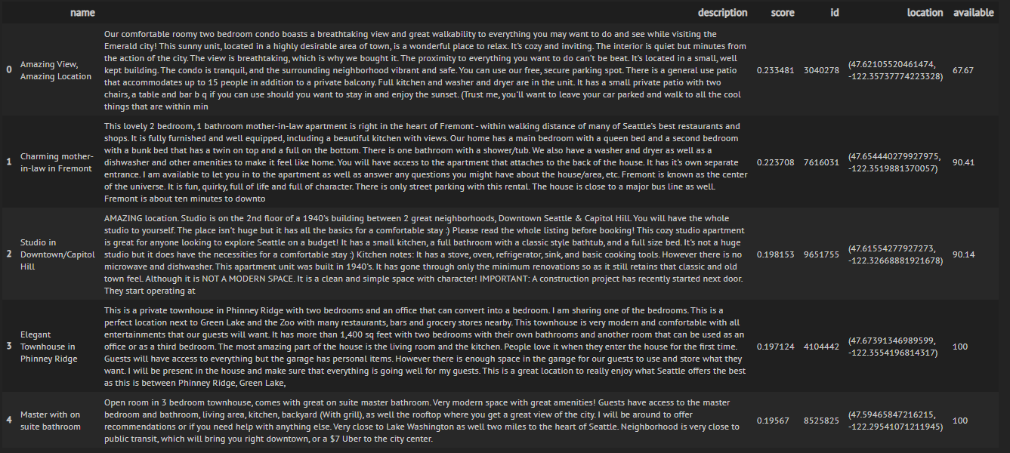

Slide 11
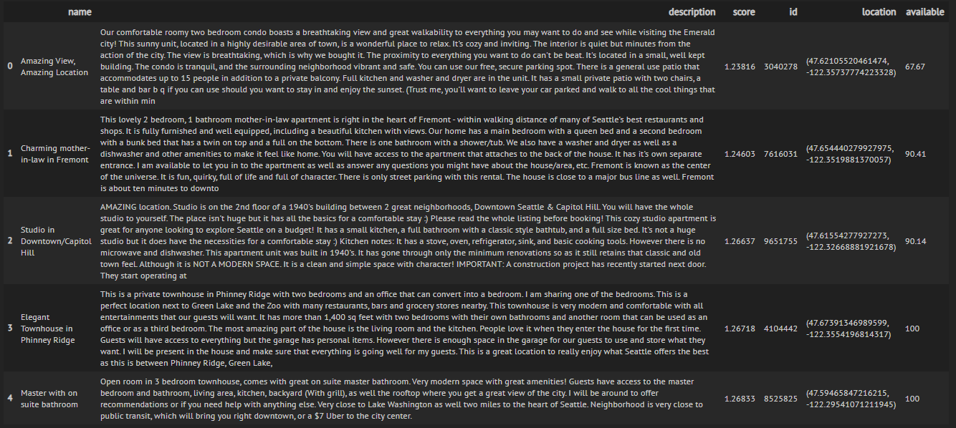
K-NN
Since we know our documents/listings are vectors
Points on graph
Find Nearest Neighbors of “User-Input point” -> Using Euclidean

Slide 12
Doc2Vec

Slide 15
Evaluation
TF-IDF
Doc2Vec

Slide 16
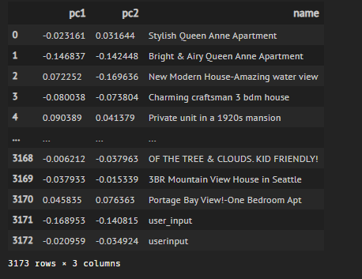
PCA
Principal Component Analysis
Dimensionality Reduction Process
Thousands of features/dimensions
2 dimension

Slide 17
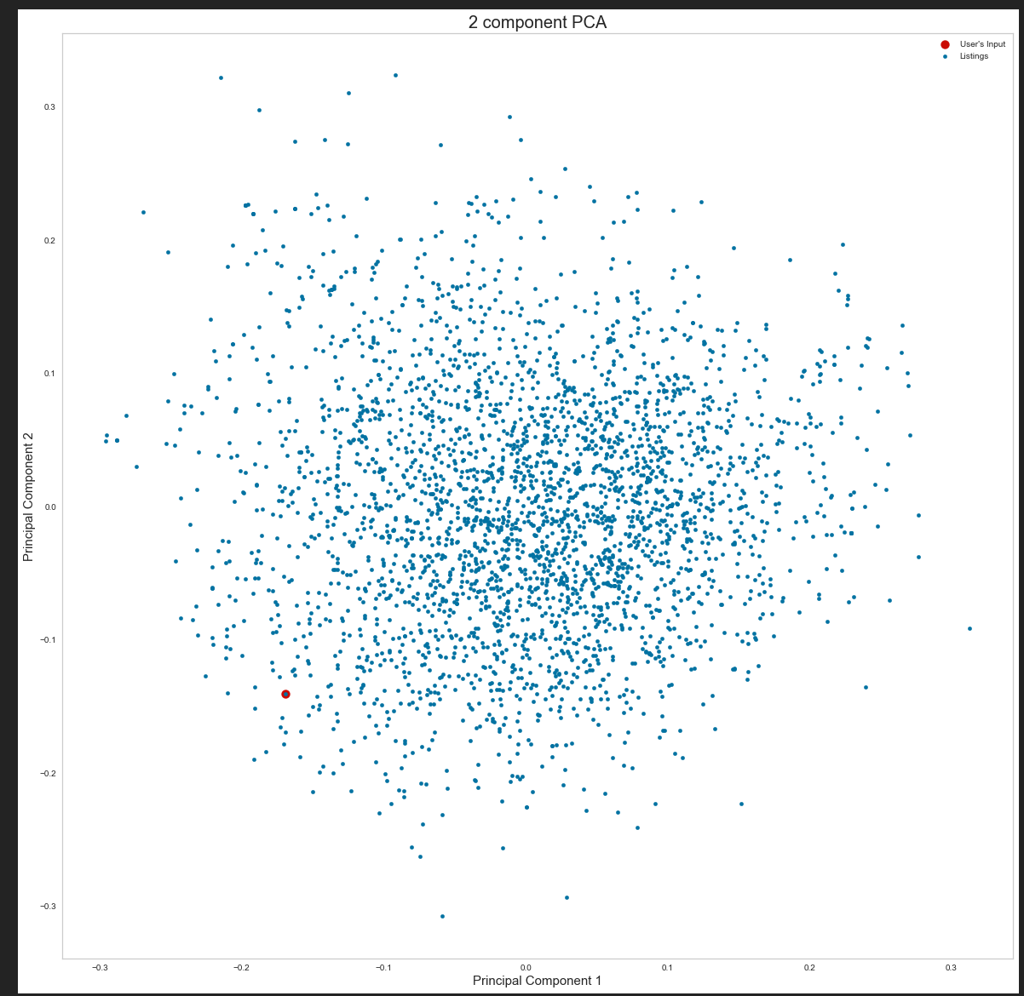
Scatter Plot of the Listings with User’s Input

Slide 18
Tensorboard Embedding Projector

Slide 23
Conclusion

Slide 24
End

